Slide 1
Memory Management
Main Memory
Paging

Slide 2
Background
Program must be brought (from disk) into memory and placed within a process for it to be run
Main memory and registers are only storage CPU can access directly
Memory unit only sees a stream of addresses + read requests, or address + data and write requests
Register access in one CPU clock (or less)
Main memory can take many cycles, causing a stall
Cache sits between main memory and CPU registers
Protection of memory required to ensure correct operation

Slide 3
Address Space
Create abstract memory space for program to exist in
Each program has its own set of addresses
The addresses are different for each program
Call it the address space of the program
Tanenbaum, Modern Operating Systems 3 e, (c) 2008 Prentice-Hall, Inc. All rights reserved. 0-13-6006639

Slide 4
Base and Limit Registers
Memory addressing is a form of dynamic relocation
Each process has a separate memory space
Base contains beginning address of program
Limit contains length of program
Program references memory, adds base address to address generated by process.
Checks to see if address is larger then limit.
If so, generates fault
Disadvantage-addition and comparison have to be done on every instruction
Tanenbaum, Modern Operating Systems 3 e, (c) 2008 Prentice-Hall, Inc. All rights reserved. 0-13-6006639

Slide 5
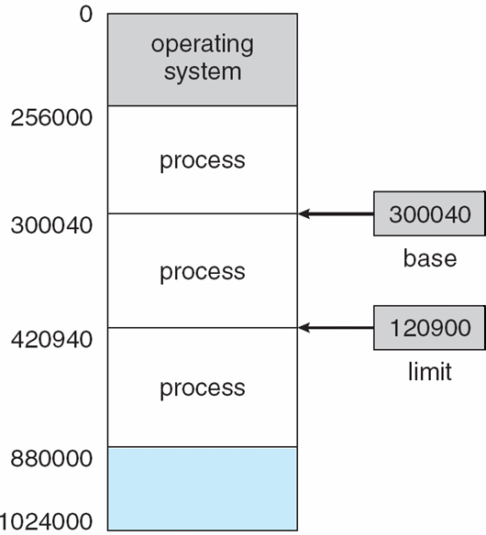
Base and Limit Registers
The pair of base and limit registers define the logical address space
CPU must check every memory access generated in user mode to be sure it is between base and limit for that user

Slide 6
Hardware Address Protection
Protection of memory space is accomplished by having the CPU hardware compare every address generated in user mode with the registers.

Slide 7
Hardware Address Protection
Any attempt by a program executing in user mode to access operating-system memory or other users’ memory results in a trap to the operating system, which treats the attempt as a fatal error
This way a user program from is prevented from (accidentally or deliberately) modifying the code or data structures of either the operating system or other users

Slide 8
Address Binding
Programs on disk, ready to be brought into memory to execute form an input queue
Further, addresses represented in different ways at different stages of a program’s life
Source code addresses usually symbolic
Compiled code addresses bind to relocatable addresses
i.e. “14 bytes from beginning of this module”
Linker or loader will bind relocatable addresses to absolute addresses
i.e. 74014
Each binding maps one address space to another

Slide 9
Binding of Instructions and Data to Memory
Address binding of instructions and data to memory addresses can happen at three different stages
Compile time: If memory location known a priori, absolute code can be generated; must recompile code if starting location changes
Load time: Must generate relocatable code if memory location is not known at compile time
Execution time: Binding delayed until run time if the process can be moved during its execution from one memory segment to another
Need hardware support for address maps (e.g., base and limit registers)

Slide 10
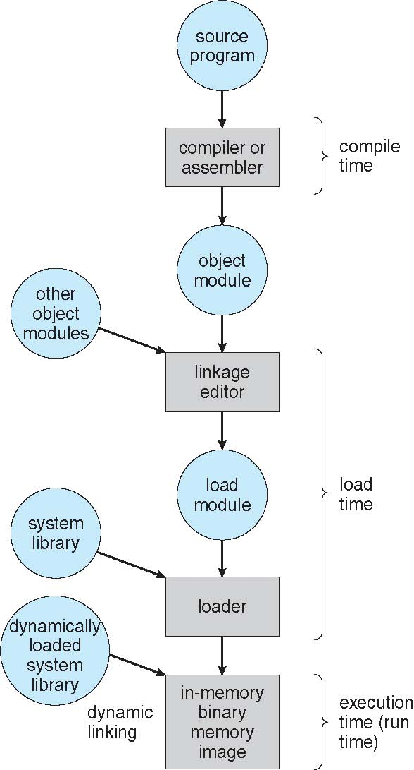
Multistep Processing of a User Program

Slide 11
Logical vs. Physical Address Space
Concept of a logical address space that is bound to a separate physical address space is central to proper memory management
Logical address – generated by the CPU; also referred to as virtual address
Physical address – address seen by the memory unit
Logical and physical addresses are the same in compile-time and load-time address-binding schemes; logical (virtual) and physical addresses differ in execution-time address-binding scheme
Logical address space is the set of all logical addresses generated by a program
Physical address space is the set of all physical addresses

Slide 12
Memory-Management Unit (MMU)
Hardware device that at run time maps virtual to physical address
Scheme where value in the relocation register is added to every address generated by a user process at the time it is sent to memory
Base register now called relocation register
MS-DOS on Intel 80x86 used 4 relocation registers
The user program deals with logical addresses; it never sees the real physical addresses
Execution-time binding occurs when reference is made to location in memory
Logical address bound to physical addresses

Slide 13
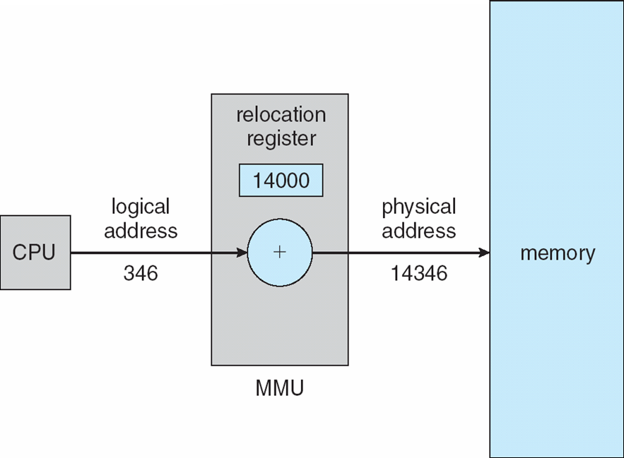
Dynamic relocation using a relocation register
Routine is not loaded until it is called
Better memory-space utilization; unused routine is never loaded
All routines kept on disk in relocatable load format
Useful when large amounts of code are needed to handle infrequently occurring cases
No special support from the operating system is required
Implemented through program design
OS can help by providing libraries to implement dynamic loading

Slide 14
Dynamic Loading
When entire program and all data of a process has to be in physical memory for the process to execute, the size of the process is limited to the size of physical memory
For better memory utilization use dynamic loading
With dynamic loading, a routine is not loaded until it is called.

Slide 15
Dynamic Loading
All routines are kept on disk in a relocatable load format.
The main program is loaded into memory and is executed.
When a routine needs to call another routine, the calling routine first checks to see whether the other routine has been loaded.
If it has not, the relocatable linking loader is called to load the desired routine into memory and to update the program’s address tables to reflect this change.
Then control is passed to the newly loaded routine
Advantage of dynamic loading is that a routine is loaded only when it is needed.

Slide 16
Dynamic Linking
Static linking – system libraries and program code combined by the loader into the binary program image
Dynamic linking –linking is postponed until execution time
Small piece of code, stub, used to locate the appropriate memory-resident library routine

Slide 17
Dynamic Linking
Stub indicates how to locate the appropriate memory-resident library routine or how to load the library if the routine is not already present.
When the stub is executed, it checks to see whether the needed routine is already in memory.
If it is not, the program loads the routine into memory.
Stub replaces itself with the address of the routine, and executes the routine
Operating system checks if routine is in processes’ memory address
If not in address space, add to address space

Slide 18
Dynamic Linking
Stub replaces itself with the address of the routine and executes the routine
Thus, the next time that particular code segment is reached, the library routine is executed directly, incurring no cost for dynamic linking.
Using stubs for dynamic linking, all processes that use a language library execute only one copy of the library code.

Slide 19
Dynamic Linking
Dynamic linking is particularly useful for libraries
This feature can be extended to library updates (such as bug fixes).
A library may be replaced by a new version, and all programs that reference the library will automatically use the new version.
System also known as shared libraries
Consider applicability to patching system libraries
Versioning may be needed

Slide 20
Memory Protection
When the CPU scheduler selects a process for execution, the dispatcher loads the relocation and limit registers with the correct values as part of the context switch.
Because every address generated by a CPU is checked against these registers, we can protect both the operating system and the other users’ programs and data from being modified by this running process.

Slide 21
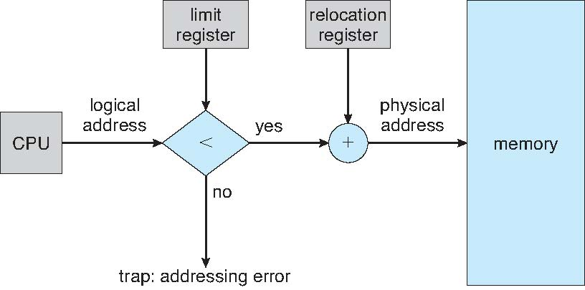
Hardware Support for Relocation and Limit Registers

Slide 22
Swapping
A process must be in memory to be executed.
A process can be swapped temporarily out of memory to a backing store, and then brought back into memory for continued execution
Total physical memory space of processes can exceed physical memory
Backing store – Commonly a fast disk large enough to accommodate copies of all memory images for all users; must provide direct access to these memory images

Slide 23
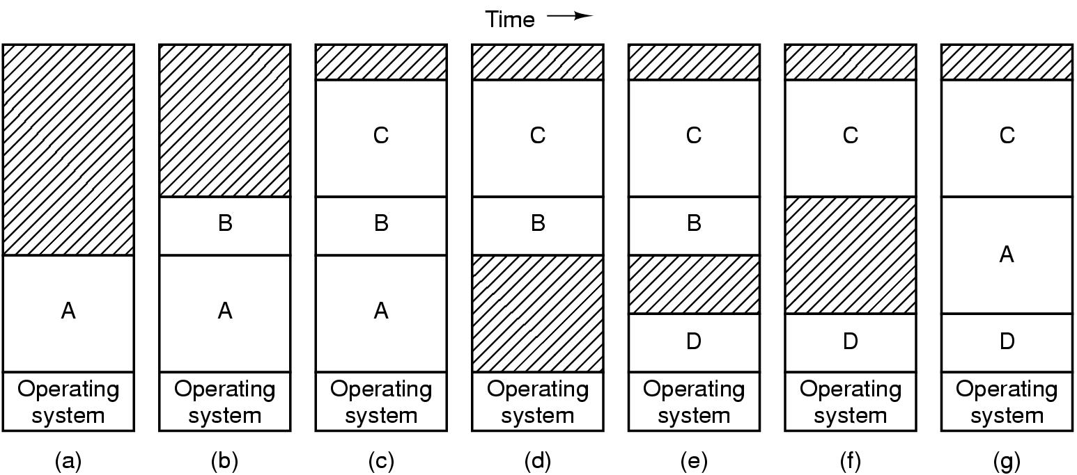
Swapping, a picture
Hole – block of available memory; holes of various size are scattered throughout memory
Can compact holes by copying programs into holes (takes too much time)

Slide 24
Programs grow as they execute
Stack (return addresses and local variables)
Data segment (heap for variables which are dynamically allocated and released)
Good idea to allocate extra memory for both
When program goes back to disk, don’t bring holes along with it!!!
Tanenbaum, Modern Operating Systems 3 e, (c) 2008 Prentice-Hall, Inc. All rights reserved. 0-13-6006639

Slide 25
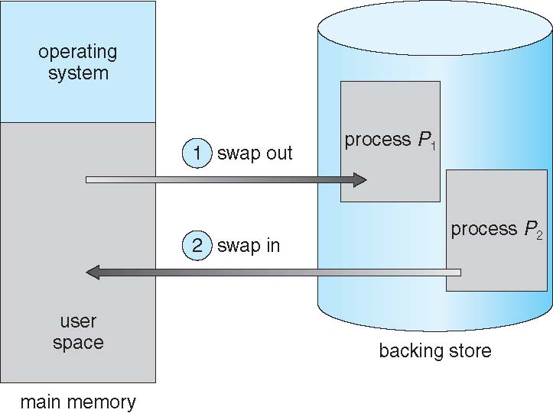
Schematic View of Swapping

Slide 26
Swapping
Roll out, roll in – swapping variant used for priority-based scheduling algorithms; lower-priority process is swapped out so higher-priority process can be loaded and executed
Major part of swap time is transfer time; total transfer time is directly proportional to the amount of memory swapped

Slide 27
Swapping
System maintains a ready queue of ready-to-run processes which have memory images on disk
Whenever the CPU scheduler decides to execute a process, it calls the dispatcher.
The dispatcher checks to see whether the next process in the queue is in memory.
If it is not, and if there is no free memory region, the dispatcher swaps out a process currently in memory and swaps in the desired process.
If we want to swap a process, we must be sure that it is completely idle
Dispatcher then reloads registers and transfers control to the selected process.

Slide 28
Swapping
Assume that the I/O operation is queued because the device is busy.
If we were to swap out process P1 and swap in process P2, the I/O operation might then attempt to use memory that now belongs to process P2.
There are two main solutions to this problem: never swap a process with pending I/O, or execute I/O operations only into operating-system buffers.
Or always transfer I/O to kernel space, then to I/O device
Known as double buffering, adds overhead
Standard swapping not used in modern operating systems
But modified version common
Swap only when free memory extremely low

Slide 29
Contiguous Allocation
Main memory must support both OS and user processes
Limited resource, must allocate efficiently
Contiguous allocation is one early method
Main memory usually into two partitions:
Resident operating system, usually held in low memory along with interrupt vector (which is almost always in low memory region)
User processes then held in high memory
Each process contained in single contiguous section of memory

Slide 30
Memory Allocation
One of the simplest methods for allocating memory is to divide memory into several fixed-sized partitions.
Each partition may contain exactly one process.
Degree of multiprogramming is bound by the number of partitions.

Slide 31
Memory Allocation
In this multiple-partition method, when a partition is free, a process is selected from the input queue and is loaded into the free partition.
When the process terminates, the partition becomes available for another process.
This method was originally used by the IBM OS/360 operating system (called MFT) but is no longer in use.
Multi-programming with a Fixed number of Tasks

Slide 32
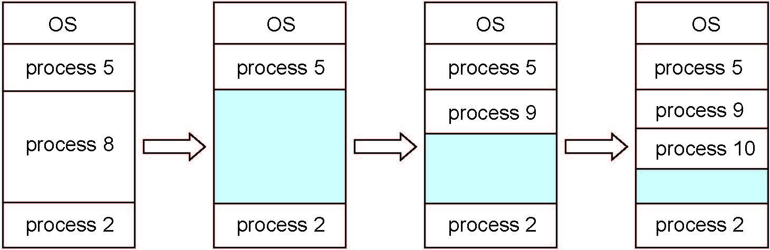
Multiple-partition allocation
In the variable-partition scheme, the operating system keeps a table indicating which parts of memory are available and which are occupied.
Variable-partition sizes for efficiency (sized to a given process’ needs)

Slide 33
Multiple-partition allocation
At any given time, then, we have a list of available block sizes and an input queue.
When a process arrives, it is allocated memory from a hole large enough to accommodate it.
Process exiting frees its partition, adjacent free partitions combined.
Operating system maintains information about: a) allocated partitions b) free partitions (hole)

Slide 34
Dynamic Storage-Allocation Problem
How to satisfy a request of size n from a list of free holes?
First-fit: Allocate the first hole that is big enough
Searching can start either at the beginning of the set of holes or at the location where the previous first-fit search ended.
We can stop searching as soon as we find a free hole that is large enough.

Slide 35
Dynamic Storage-Allocation Problem
Best-fit: Allocate the smallest hole that is big enough; must search entire list, unless ordered by size
Produces the smallest leftover hole
Worst-fit: Allocate the largest hole; must also search entire list
Produces the largest leftover hole which may be more useful than the smaller leftover hole
First-fit and best-fit better than worst-fit in terms of speed and storage utilization

Slide 36
External Fragmentation
As processes are loaded and removed from memory, free memory space is broken into little pieces.
External fragmentation exists when there is enough total memory space to satisfy a request but the available spaces are not contiguous: storage is fragmented into a large number of small holes.
In the worst case, we could have a block of free (or wasted) memory between every two processes.
If all these small pieces of memory were in one big free block instead, we might be able to run several more processes.

Slide 37
Internal Fragmentation
Allocated memory may be slightly larger than requested memory; this size difference is memory internal to a partition, but not being used
First fit analysis reveals that given N blocks allocated, another 50% blocks are lost to fragmentation
1/3 may be unusable -> 50-percent rule

Slide 38
Fragmentation (Cont.)
Reduce external fragmentation by compaction
Shuffle memory contents to place all free memory together in one large block
Compaction is possible only if relocation is dynamic, and is done at execution time
I/O problem
Keep the job in memory while it is involved in I/O
Do I/O only into OS buffers
Another possible solution to the external-fragmentation problem is to permit the logical address space of the processes to be noncontiguous, thus allowing a process to be allocated physical memory wherever such memory is available.

Slide 39
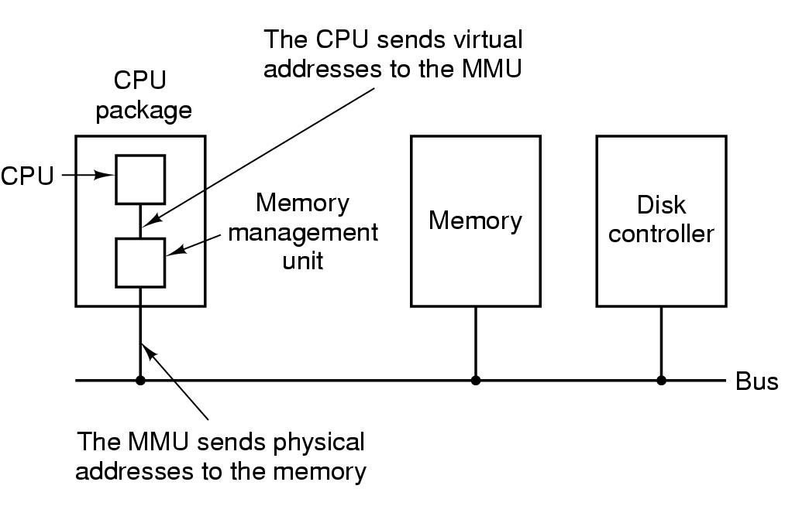
Memory Management Unit
MMU maps virtual addresses to physical addresses and puts them on memory bus
Tanenbaum, Modern Operating Systems 3 e, (c) 2008 Prentice-Hall, Inc. All rights reserved. 0-13-6006639

Slide 40
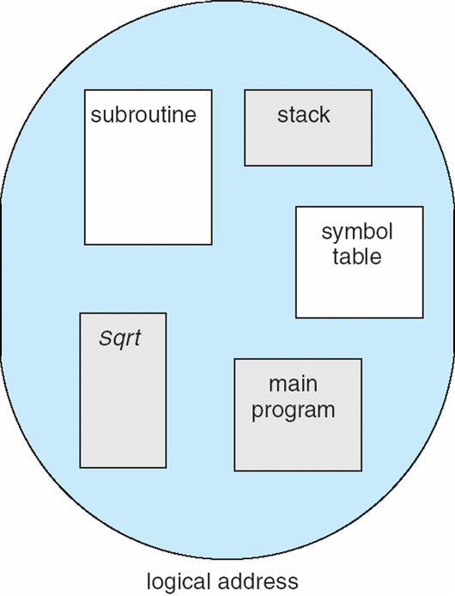
User’s View of a Program

Slide 41
Segmentation
A program is a collection of segments
A segment is a logical unit such as:
main program, procedure, function, method
object
local variables, global variables
common block
stack
symbol table
arrays
Segmentation is the memory-management scheme that supports user view of memory

Slide 42
Segmentation …
When a program is compiled, the compiler automatically constructs segments reflecting the input program
Each segment has a name and a length.
A logical address space is a collection of segments.
The addresses specify both the segment name and the offset within the segment.
The programmer therefore specifies each address by two quantities: a segment name and an offset.

Slide 43
Logical View of Segmentation
1
1
4
2
3
4
2
3
user space
physical memory space

Slide 44
Segmentation
A C compiler might create separate segments for the following:
The code
Global variables
The heap, from which memory is allocated
The stacks used by each thread
The standard C library
Libraries that are linked in during compile time might be assigned separate segments.
The loader would take all these segments and assign them segment numbers.

Slide 45
Segmentation
A segmented memory allows each table to grow or shrink independently of the other tables.
Tanenbaum, Modern Operating Systems 3 e, (c) 2008 Prentice-Hall, Inc. All rights reserved. 0-13-6006639

Slide 46
Segmentation Architecture
Logical address consists of a two tuple:
<segment-number, offset>,
Segment table – maps two-dimensional physical addresses; each table entry has:
base – contains the starting physical address where the segments reside in memory
limit – specifies the length of the segment
Segment-table base register (STBR) points to the segment table’s location in memory
Segment-table length register (STLR) indicates number of segments used by a program

Slide 47
Segmentation Hardware
A logical address consists of two parts: a segment number, s, and an offset into that segment, d.
Segment number is an index to the segment table.
The offset d of the logical address must be between 0 and the segment limit.
If it is not, we trap to the operating system (logical addressing attempt beyond end of segment).
When an offset is legal, it is added to the segment base to produce the address in physical memory of the desired byte.

Slide 48
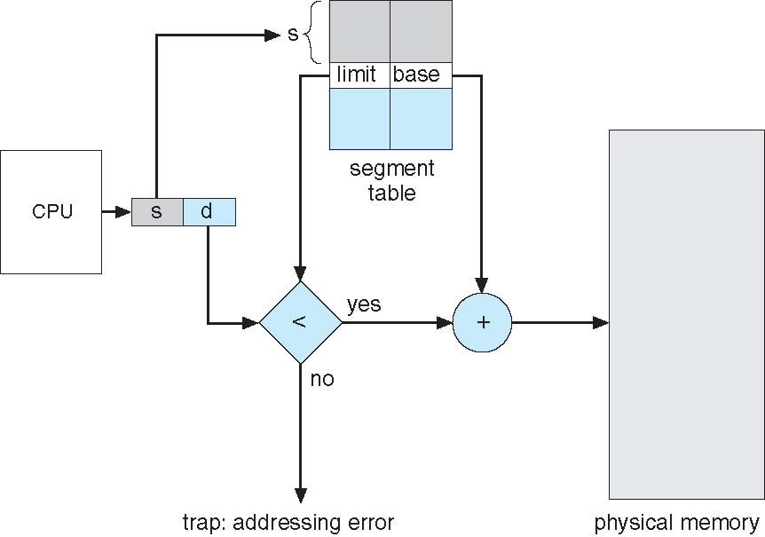
Segmentation Hardware

Slide 49
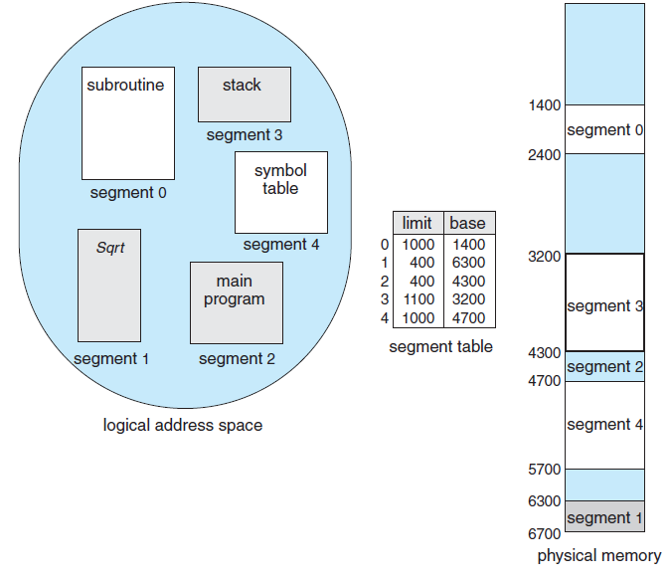
Example
A reference to byte 53 of segment 2 is mapped onto
location 4300 + 53 = 4353.
A reference to segment 3, byte 852, is mapped to 3200
(the base of segment 3) + 852 = 4052.

Slide 50
Paging
Segmentation permits the physical address space of a process to be non-contiguous.
Paging is another memory-management scheme that offers this advantage.
Physical address space of a process can be noncontiguous; process is allocated physical memory whenever the latter is available
Avoids external fragmentation
Avoids problem of varying sized memory chunks
Provides solution to storage in backing store also

Slide 51
Paging
Divide physical memory into fixed-sized blocks called frames
Size is power of 2, between 512 bytes and 16 Mbytes
Divide logical memory into blocks of same size called pages
Keep track of all free frames

Slide 52
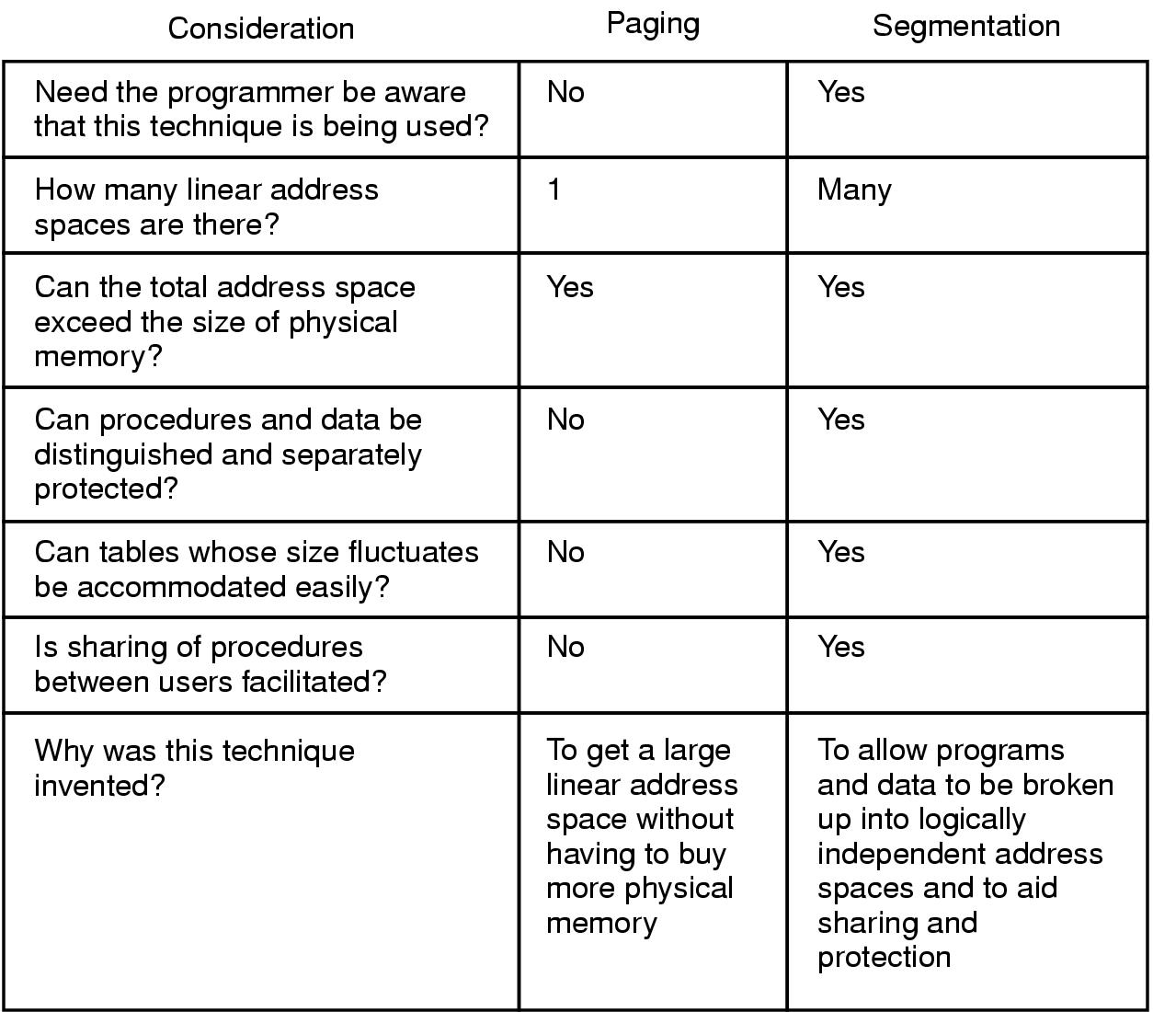
Paging vs Segmentation
Comparison of paging and segmentation
Tanenbaum, Modern Operating Systems 3 e, (c) 2008 Prentice-Hall, Inc. All rights reserved. 0-13-6006639

Slide 53
Paging …
To run a program of size N pages, we need to find N free frames in physical memory and load program during execution
Set up a page table to translate logical to physical addresses (contains base address of each page)
The backing store is divided into fixed-sized blocks that are of same size as memory frames or clusters of multiple frames
Still have Internal fragmentation

Slide 54
Hardware Support for Addresses
Address generated by CPU is divided into:
Page number (p) – used as an index into a page table which contains base address of each page in physical memory (called f)
Page offset (d) – combined with base address to define the physical memory address that is sent to the memory unit
If the size of the logical address space is 2^{m}, and a page size is 2^{n} bytes, then the high-order m− n bits of a logical address designate the page number, and the n low-order bits designate the page offset.

Slide 55
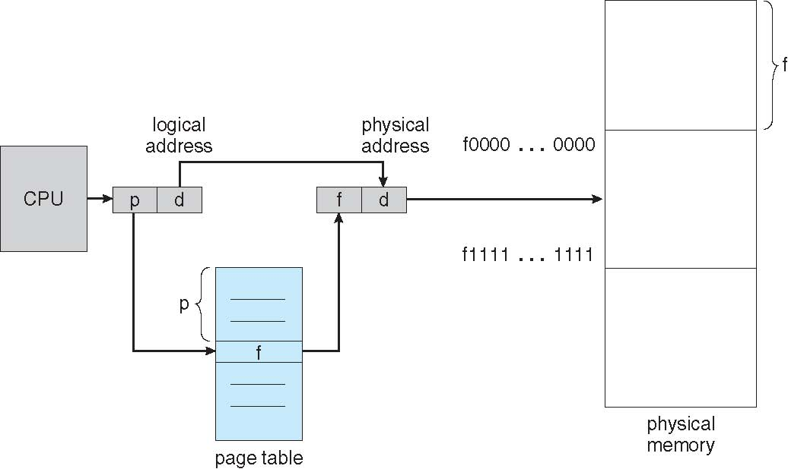
Paging Hardware

Slide 56
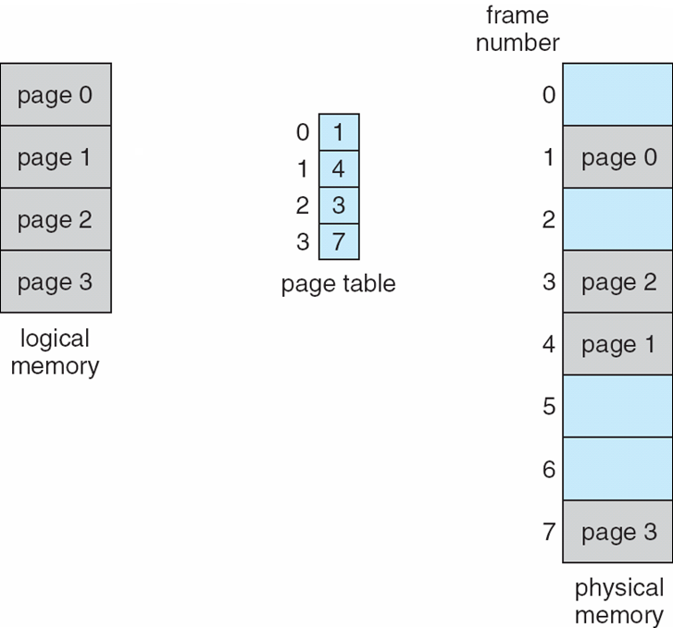
Paging Model of Logical and Physical Memory

Slide 57
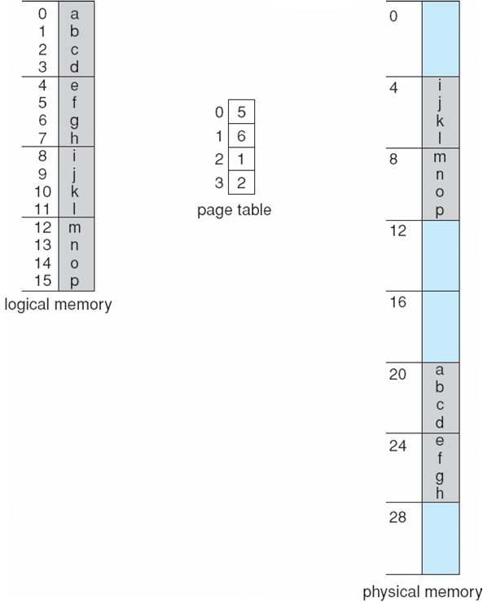
Paging Example
n=2 and m=4
32-byte physical memory (8 pages) and 4-byte pages
Logical address 0 is page 0, offset 0.
Indexing into the page table, page 0 is in frame 5.
Logical address 0 maps to physical address 20 [= (5 × 4) + 0].
Logical address 3 (page 0, offset 3) maps to physical address 23 [= (5 × 4) + 3].
Logical address 4 is page 1, offset 0; according to the page table, page 1 is mapped to frame 6. Thus, logical address 4 maps to physical address 24 [= (6 × 4) + 0].
Logical address 13 maps to physical address 9.

Slide 58
Internal Fragmentation
If the memory requirements of a process do not happen to coincide with page boundaries, the last frame allocated may not be completely full.
For example, if page size is 2,048 bytes, a process of 72,766 bytes will need 35 pages plus 1,086 bytes.
It will be allocated 36 frames, resulting in internal fragmentation of 2,048 − 1,086 = 962 bytes.
In the worst case, a process would need n pages plus 1 byte.
It would be allocated n + 1 frames, resulting in internal fragmentation of almost an entire frame.

Slide 59
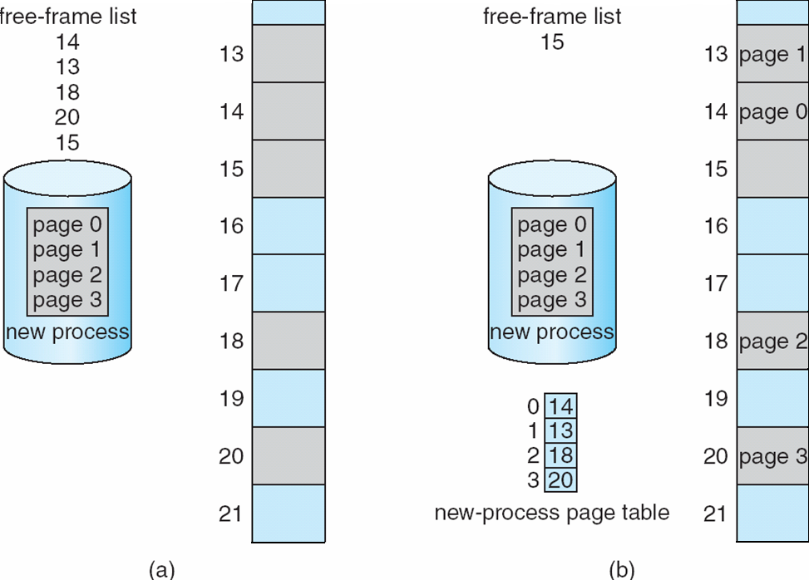
Free Frames
Before allocation
After allocation

Slide 60
Hardware Support for PT
Each operating system has its own methods for storing page tables.
Some allocate a page table for each process.
When the dispatcher is told to start a process, it must reload the user registers and define the correct hardware page-table values from the stored user page table
A pointer to the page table is stored with the other register values (like the instruction counter) in the process control block.

Slide 61
Hardware Support for PT
In the simplest case, the page table is implemented as a set of dedicated registers.
These registers should be built with very high-speed logic to make the paging-address translation efficient.
Every access to memory must go through the paging map
Efficiency is a major consideration.
CPU dispatcher reloads these registers, just as it reloads the other registers.

Slide 62
Implementation of Page Table
Large page table entries: Page table is kept in main memory
Page-table base register (PTBR) points to the page table
Page-table length register (PTLR) indicates size of the page table
Every data/instruction access requires two memory accesses
One for the page table and one for the data / instruction
The two memory access problem can be solved by the use of a special fast-lookup hardware cache called associative memory or translation look-aside buffers (TLBs)

Slide 63
Translation Look-aside Buffers (TLBs)
Each entry in the TLB consists of two parts: a key (or tag) and a value.
When TLB is presented with an item, the item is compared with all keys simultaneously.
If the item is found, the corresponding value field is returned.

Slide 64
Translation Look-aside Buffers (TLBs)
TLB lookup is part of the instruction pipeline
To be able to execute the search within a pipeline step however, the TLB must be kept small.
It is typically between 32 and 1,024 entries in size.

Slide 65
Associative Memory
Associative memory – parallel search
Address translation (p, d)
If p is in associative register, get frame # out
Otherwise get frame # from page table in memory

Slide 66
Translation Look-aside Buffers (TLBs)
TLB contains only a few of the page-table entries.
When a logical address is generated by the CPU, its page number is presented to the TLB.
If the page number is found, its frame number is immediately available and is used to access memory.

Slide 67
Implementation of Page Table – ASIDs (Cont.)
Some TLBs store address-space identifiers (ASIDs) in each TLB entry
uniquely identifies each process to provide address-space protection for that process
When the TLB attempts to resolve virtual page numbers, it ensures that the ASID for the currently running process matches the ASID associated with the virtual page
Allows the TLB to contain entries for several different processes simultaneously

Slide 68
Implementation of Page Table (Cont.)
The percentage of times that the page number of interest is found in the TLB is called the hit ratio.
On a TLB miss, value is loaded into the TLB for faster access next time
Replacement policies must be considered e.g. LRU, random, round-robin
Some entries can be wired down for permanent fast access (e.g. key kernel code)

Slide 69
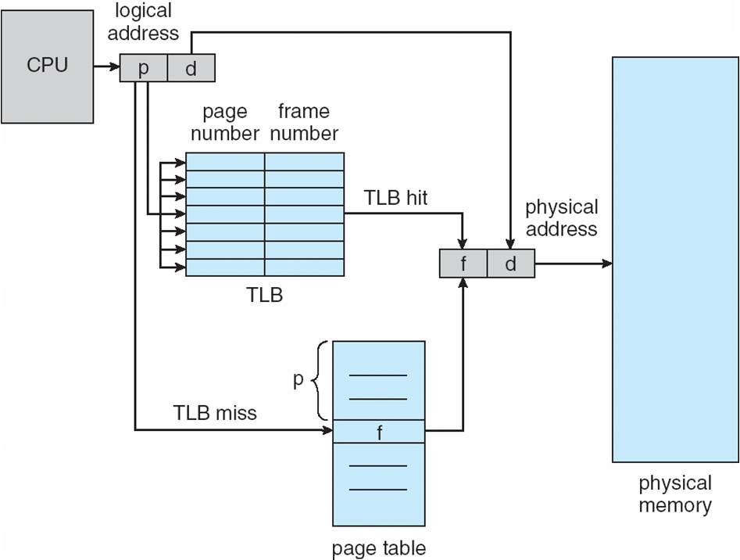
Paging Hardware With TLB

Slide 70
Effective Access Time
Hit ratio = α is related to number of associative registers
Consider α = 80%, If it takes 100 nanoseconds to access memory, then a mapped-memory access takes 100 nanoseconds when the page number is in the TLB.
If we fail to find the page number in the TLB then we must first access memory for the page table and frame number (100 nanoseconds) and then access the desired byte in memory (100 nanoseconds)
Effective Access Time (EAT)
= 0.80 x 100 + 0.20 x 200 = 120ns

Slide 71
Memory Protection
Implemented by associating protection bit with each frame to indicate if read-only or read-write access is allowed
Can also add more bits to indicate page execute-only, and so on
Normally, these bits are kept in the page table.
Illegal attempts will be trapped to the operating system

Slide 72
Memory Protection
Valid-invalid bit attached to each entry in the page table:
“valid” indicates that the associated page is in the process’ logical address space, and is thus a legal page
“invalid” indicates that the page is not in the process’ logical address space
Illegal addresses are trapped by use of the valid–invalid bit.
The operating system sets this bit for each page to allow or disallow access to the page.
Or use page-table length register (PTLR)
Indicates the size of the page table.
This value is checked against every logical address to verify that the address is in the valid range for the process.
Failure of this test causes an error trap to the operating system.

Slide 73
Example
In a system with a 14-bit address space (0 to 16383), a program uses only addresses 0 to 10468.
Given a page size of 2 KB, obtain the address ranges for pages 0 – 5.
Is there internal fragmentation?

Slide 74
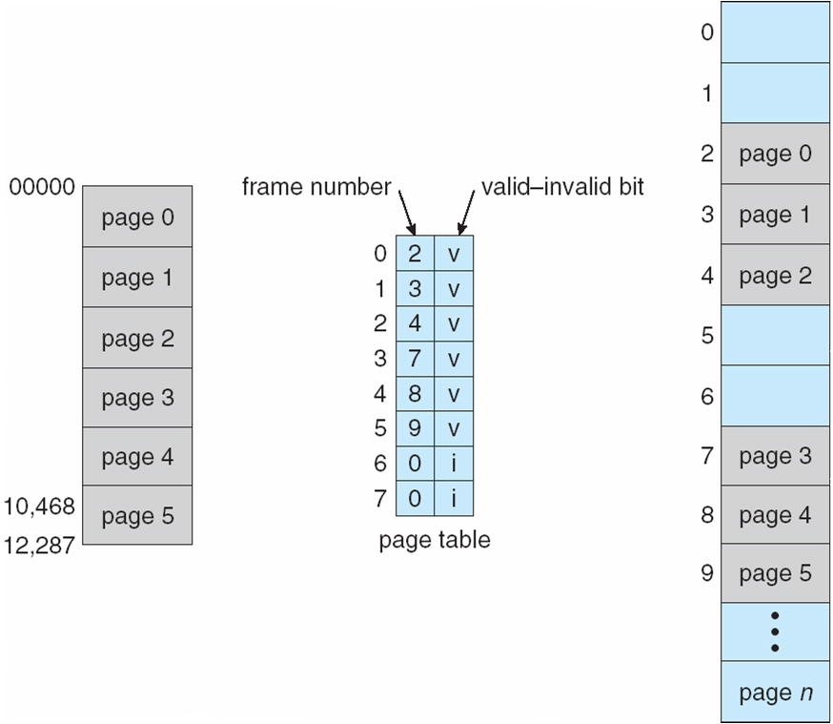
Valid (v) or invalid (i) bit in a page table

Slide 75
Reentrant Code
Reentrant code or pure code is non-self-modifying code: it never changes during execution
Thus, two or more processes can execute the same code at the same time
Each process has its own copy of registers and data storage to hold the data for the process’s execution
The data for two different processes will be different

Slide 76
Shared Pages
Shared code
One copy of read-only (reentrant) code shared among processes (i.e., text editors, compilers, window systems)
Similar to multiple threads sharing the same process space
Also useful for IPC if sharing of read-write pages is allowed
Private code and data
Each process keeps a separate copy of the code and data
Pages for the private code and data can appear anywhere in the logical address space

Slide 77
Example
40 users (150KB Code + 50 KB data) each executing a text editor
Only one copy of the editor need be kept in physical memory.
Each user’s page table maps onto the same physical copy of the editor, but data pages are mapped onto different frames.
Only one copy of the editor (150 KB), plus 40 copies of the 50 KB of data space per user are needed.
Total space required is 2,150 KB instead of 8,000 KB

Slide 78
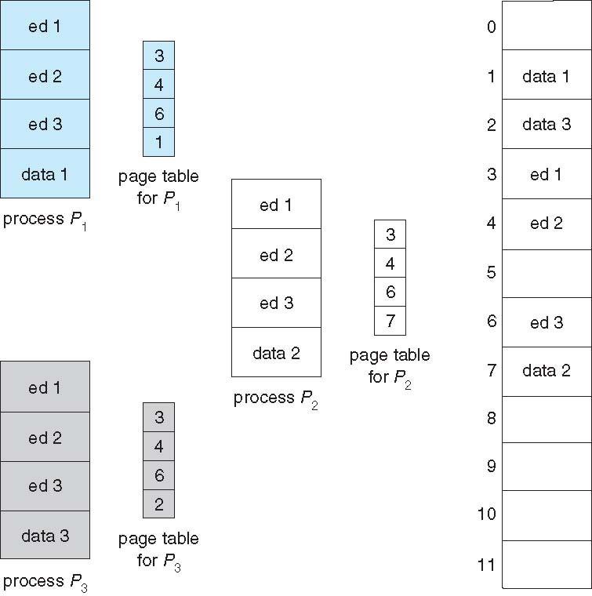
Shared Pages Example

Slide 79
Structures of the Page Table
Most modern computer systems support a large logical address space (2³² to 2⁶⁴).
Memory structures for paging can get very huge
Consider a 32-bit logical address space as on modern computers
Page size of 4 KB = 4096 Bytes (2¹²)
Page table would have 1 million entries (2³² / 2¹²)
If each entry is 4 bytes -> 4 MB of physical address space / memory for page table alone
That amount of memory used to cost a lot
Don’t want to allocate that contiguously in main memory
Hierarchical Paging
Hashed Page Tables
Inverted Page Tables

Slide 80
Hierarchical Page Tables
Break up the logical address space into multiple page tables
A simple technique is a two-level page table
We then page the page table i.e. page table itself is also paged

Slide 81
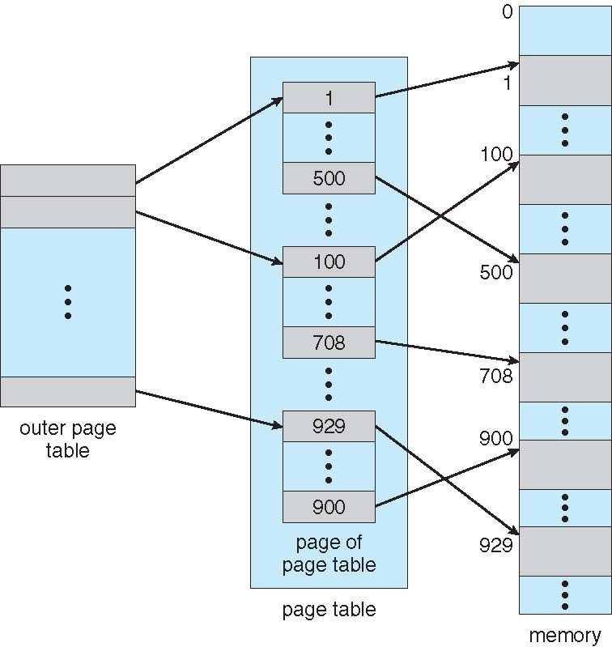
Two-Level Page-Table Scheme

Slide 82
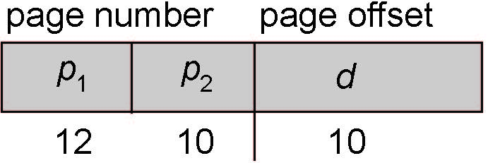
Two-Level Paging Example
A logical address (on 32-bit machine with 1K page size) is divided into:
a page number consisting of 22 bits
a page offset consisting of 10 bits
Since the page table is paged, the page number is further divided into:
a 12-bit page number
a 10-bit page offset
A logical address is as follows:
where p₁ is an index into the outer page table, and p₂ is the displacement within the page of the inner page table
Known as forward-mapped page table

Slide 83
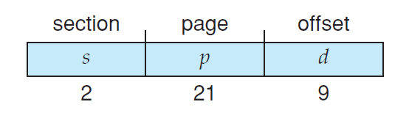
Two-Level Paging Example
VAX (DEC) a 32-bit machine has a page size of 512 bytes.
The logical address space of a process is divided into four equal sections, each of which consists of 2³⁰ bytes.
Each section represents a different part of the logical address space of a process.
First 2 high-order bits of the logical address designate the appropriate section.
Next 21 bits represent the logical page number of that section, and the final 9 bits represent an offset in the desired page.

Slide 84
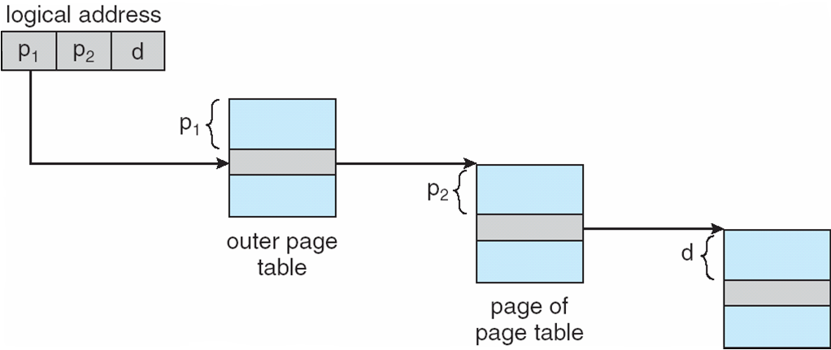
Address-Translation Scheme

Slide 85
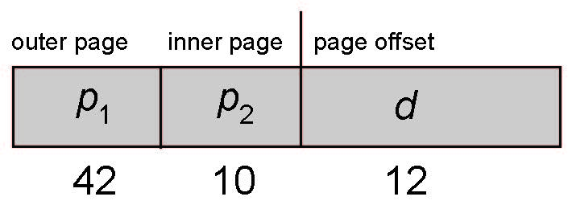
64-bit Logical Address Space
Even two-level paging scheme not sufficient
If page size is 4 KB (2¹²)
Then page table has 2⁵² entries
If two level scheme, inner page tables could be 2¹⁰ 4-byte entries
Address would look like
Outer page table has 2⁴² entries or 2⁴⁴ bytes
Add a 2nd / 3rd outer page table
2nd outer page table sizes
And possibly 4/more memory access to get to one physical memory location

Slide 86
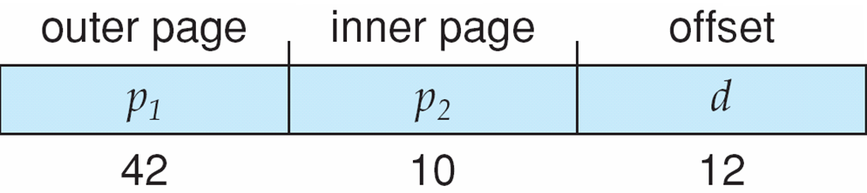
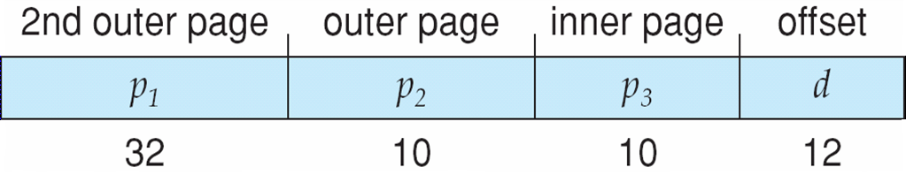
Three-level Paging Scheme

Slide 87
Problem
Consider a logical address space of 32 pages with 1024 words per page; mapped onto a physical memory of 16 frames.
a. How many bits are required in the logical address?
b. How many bits are required in the physical address?
Note:
Size of the page table is given by first m-n bits of the logical address.
The last n bits of the logical address provide the page size or the words per page.
Length of Logical Address, m (in Bits)
= Bits to address Page Table (m-n) + Bits to address Words in each Page, n
Size of the physical memory is equal to
Frame (page) size x number of frames in the physical memory.
Bits required in the Physical address = Bits required in accessing each frame + Bits needed to access total frames
Solution
a. Bits to address Page Table i.e. 32 pages = log₂32 = 5 bits
Bits to address Words in each page (for offset) = log₂1024 = 10 bits
Therefore, Length of Logical Address in bits = 5 + 10 = 15 bits
b.
(i) Here, bits required for page size for 1024 words per page = 10 bits
Number of pages in physical memory = number of frames of physical memory = 16
So, bits needed for accessing each page (frame) = 4 bits
Therefore, Length of Physical Address (bits) = 10 + 4 = 14 bits
(ii) Size of Physical Memory = 2¹⁴ words = 16K words
If each word is of 4 bytes then size of physical memory = 16K x 4 Bytes = 64K Bytes

Slide 88
Hashed Page Tables
Common in address spaces > 32 bits
The virtual page number is hashed into a page table
This page table contains a chain of elements hashing to the same location
Each element contains
Virtual page number
Value of the mapped page frame
A pointer to the next element

Slide 89
Hashed Page Tables
Virtual page numbers are compared in this chain with field 1 searching for a match
If a match is found, the corresponding physical frame (field 2) is extracted to from the physical address
If there is no match, subsequent entries in the linked list are searched for a matching virtual page number.

Slide 90
Hashed Page Tables
Variation for 64-bit addresses is clustered page tables
Similar to hashed but each entry refers to several pages (such as 16) rather than 1
Especially useful for sparse address spaces (where memory references are non-contiguous and scattered)

Slide 91
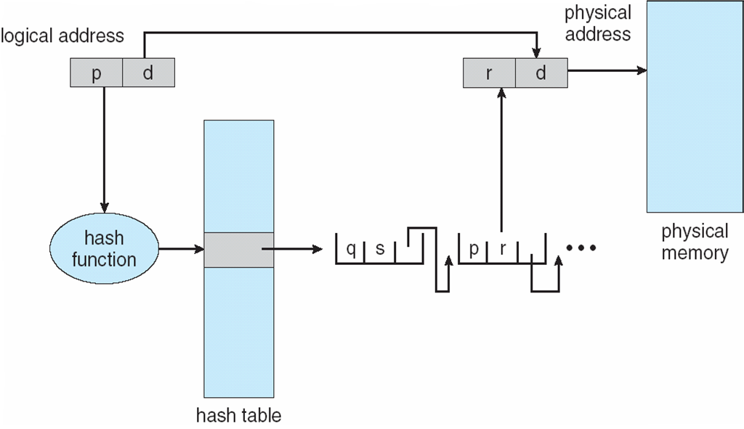
Hashed Page Table

Slide 92
Inverted Page Table
Rather than each process having a page table and keeping track of all possible logical pages, track all physical pages
One entry for each real page of memory
Entry consists of the virtual address of the page stored in that real memory location, with information about the process that owns that page

Slide 93
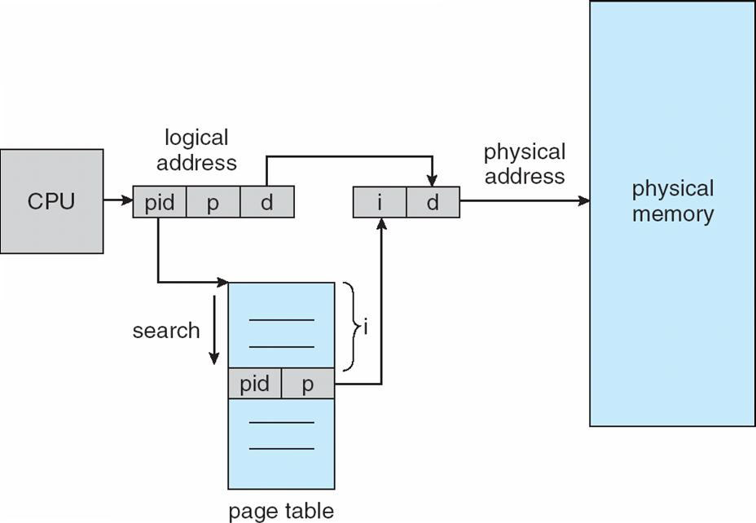
Inverted Page Table Architecture

Slide 94
Inverted Page Table
Decreases memory needed to store each page table, but increases time needed to search the table when a page reference occurs
Use hash table to limit the search to one — or at most a few — page-table entries
TLB can accelerate access
But how to implement shared memory?
One mapping of a virtual address to the shared physical address

Slide 95
Inverted Page Table
Systems that use inverted page tables have difficulty implementing shared memory.
Shared memory is usually implemented as multiple virtual addresses (one for each process sharing the memory) that are mapped to one physical address.

Slide 96
Problem
Consider a computer system with a 32-bit logical address and 4-KB page size. The system supports up to 512 MB of physical memory. How many entries are there in each of the following?
a. A conventional single-level page table?
b. An inverted page table?
Answer:
a. Number of entries in the page table will be same as 2^{m-n}
Number of bits, n for offset i.e. word in a page of size 4KB = 12 bits
Thus, m-n = 32 – 12 = 20 bits
Therefore, the number of entries in the page table = 2²⁰ entries.
b. 512 MB/4KB = 128K entries.

Slide 97
Example
Sun (Oracle) Sparc Solaris
Uses Translation Table Entries copied into TLBs called Translation Storage Buffer (TSB) [Hashing]
IBM RS/6000 Power CPUs
Pentium CPUs are 32-bit and called IA-32 architecture
Current Intel CPUs are 64-bit and called IA-64 architecture

Slide 98
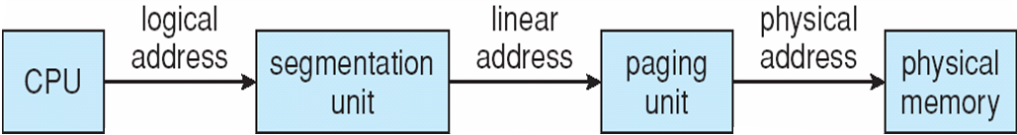
IA-32
Memory management in IA-32 systems is divided into two components —
segmentation and paging

Slide 99
Example: The Intel IA-32 Architecture
Supports both segmentation and segmentation with paging
Each segment can be 4 GB
Up to 16 K segments per process
Divided into two partitions
First partition of up to 8 K segments are private to process (kept in local descriptor table (LDT))
Second partition of up to 8K segments shared among all processes (kept in global descriptor table (GDT))

